Slide 1




COLLEGE RECOMMENDATION SYSTEM

Slide 2

Department of Information Technology Project Phase –II
Summer 2023 (Session: 2022-2023)
Title of the Project:- College Recommendation System
Presented By:
Parth Mandhare(A-31)
Prajesh Dhande(A-33)
Prajwal Rathod(A-34)
Guide:-
Prof. Sonali Guhe
Assistant Professor
GHRCE ,Nagpur

Slide 3


Introduction
Making a career decision by selecting the appropriate college is very important for every students.
Students get confused while filling the form of admission process, due to improper information and lack of knowledge about how to set the preference list of colleges
In today’s world with growing technologies, there are many tools build to reduce the human work and help them work efficiently.
Recommend correct and suitable college to the students.
AI and Machine learning techniques are widely used in these scenarios..

Slide 4

Objective
The system aims to help students make informed decisions about their higher education by providing
them with a list of colleges and universities that best match their needs and preferences.
To reduce the manual work(comparing prospectus, keeping in mind choice codes) of the students.
To guide the students toward a right future by helping them to select a good college.
System is designed to be flexible and adaptable to accommodate changes in student needs and preferences.

Slide 5

Solution
Recommendation techniques mostly uses data collection, data processing, data analysis and machine learning algorithm for providing required output.
College Recommendation System is a user-friendly web based application that is easy to use and handle.
The system is been tested before implementing and is providing 89% accurate result.
This project will help the high school students to get the list of colleges based on their scores.

Slide 6

System Overview
The system is designed to be user-friendly, secure, and privacy-conscious while integrating with other systems to provide a seamless experience for students.
The system collects data from various sources and extract relevant information.
Then system analyzes the data to identify patterns and correlations that can be used to generate personalized recommendations.
The system continuously collects feedback from students and uses this feedback to improve the accuracy and relevance of future recommendations.
The system provides an clean user interface for students to access their personalized recommendations, explore colleges and universities, and provide feedback.

Slide 7
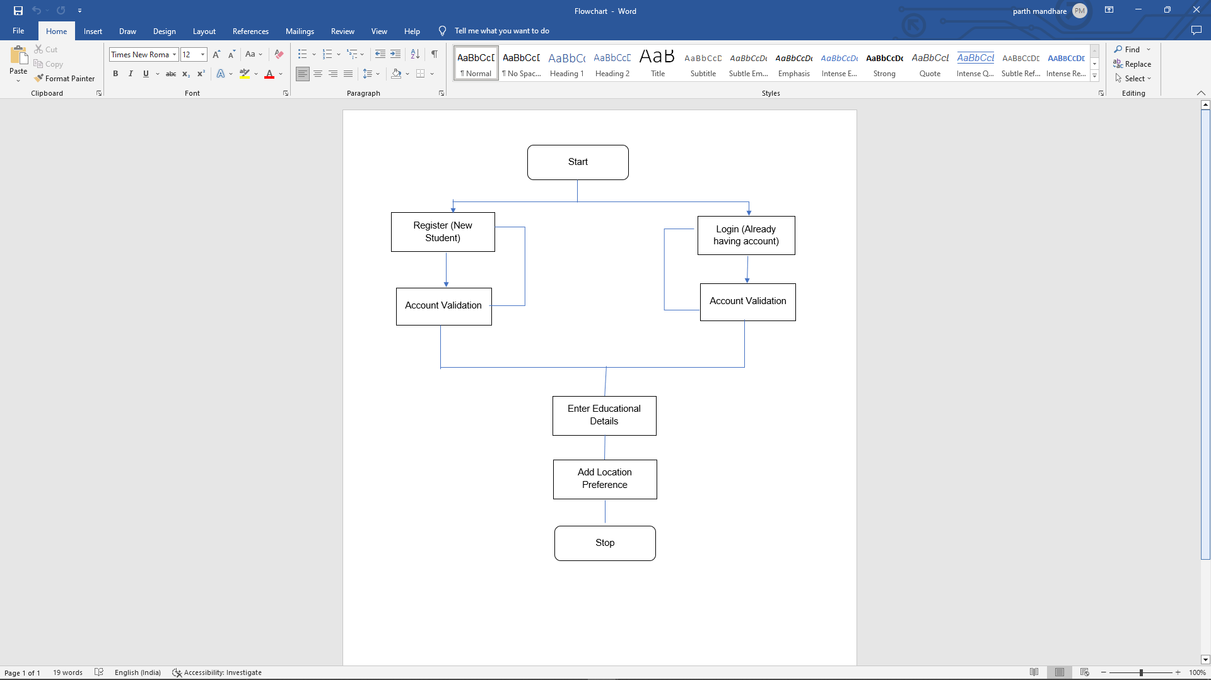
System Flow
Start
Register
Login
Enter Details
Result

Slide 8
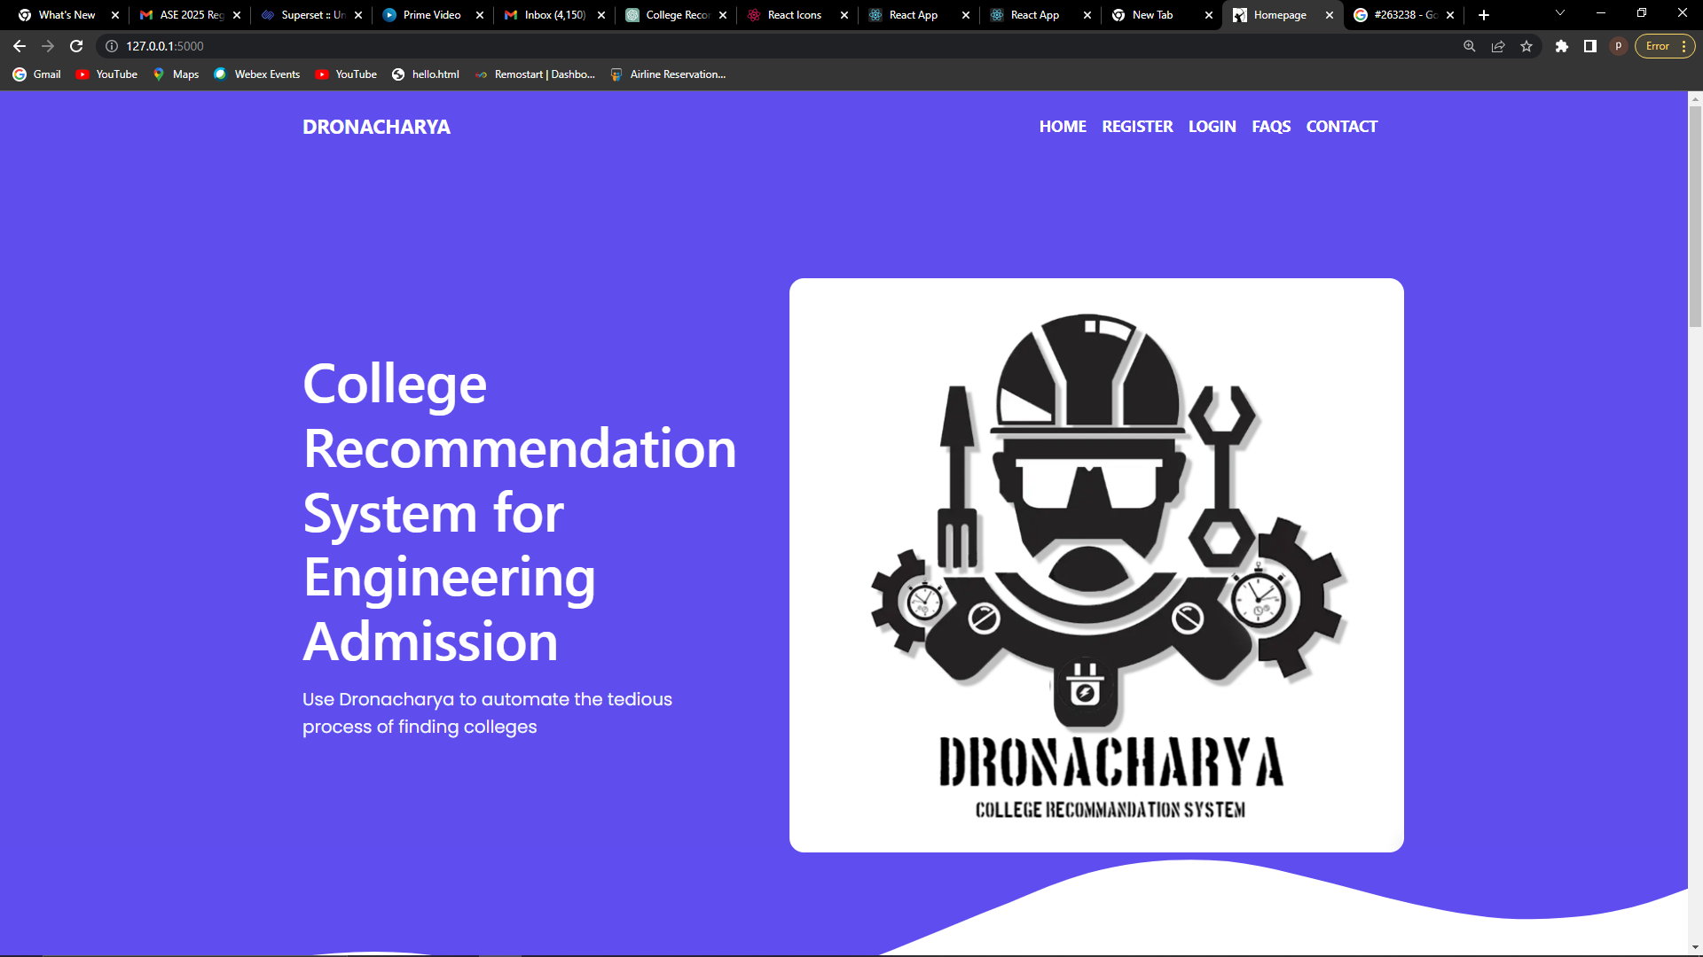
Model I-Frontend Development
Landing Page

Slide 9
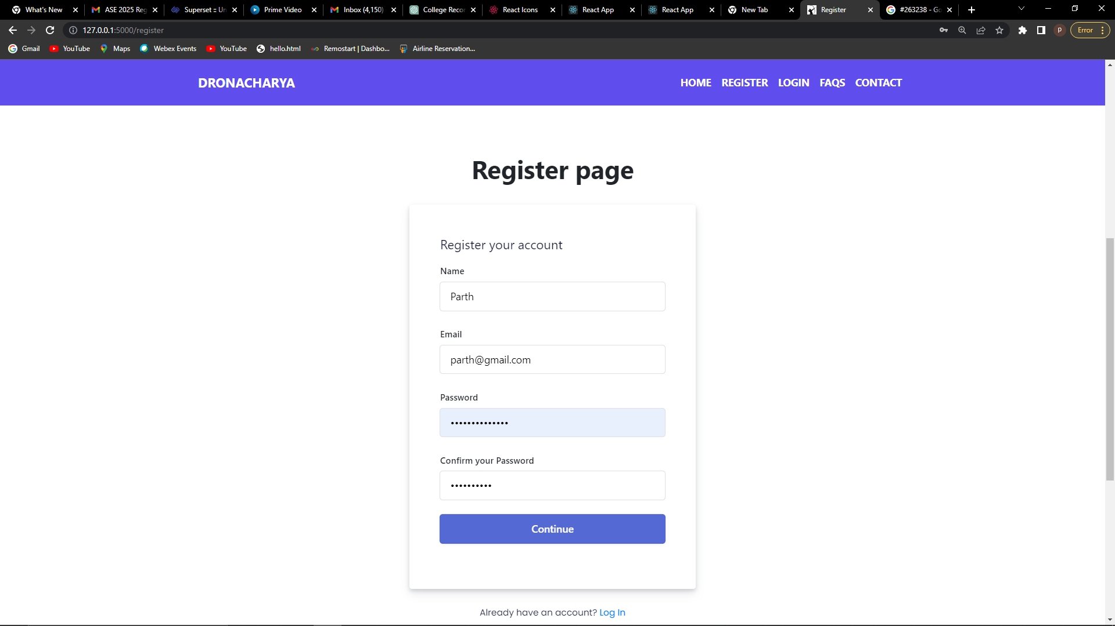
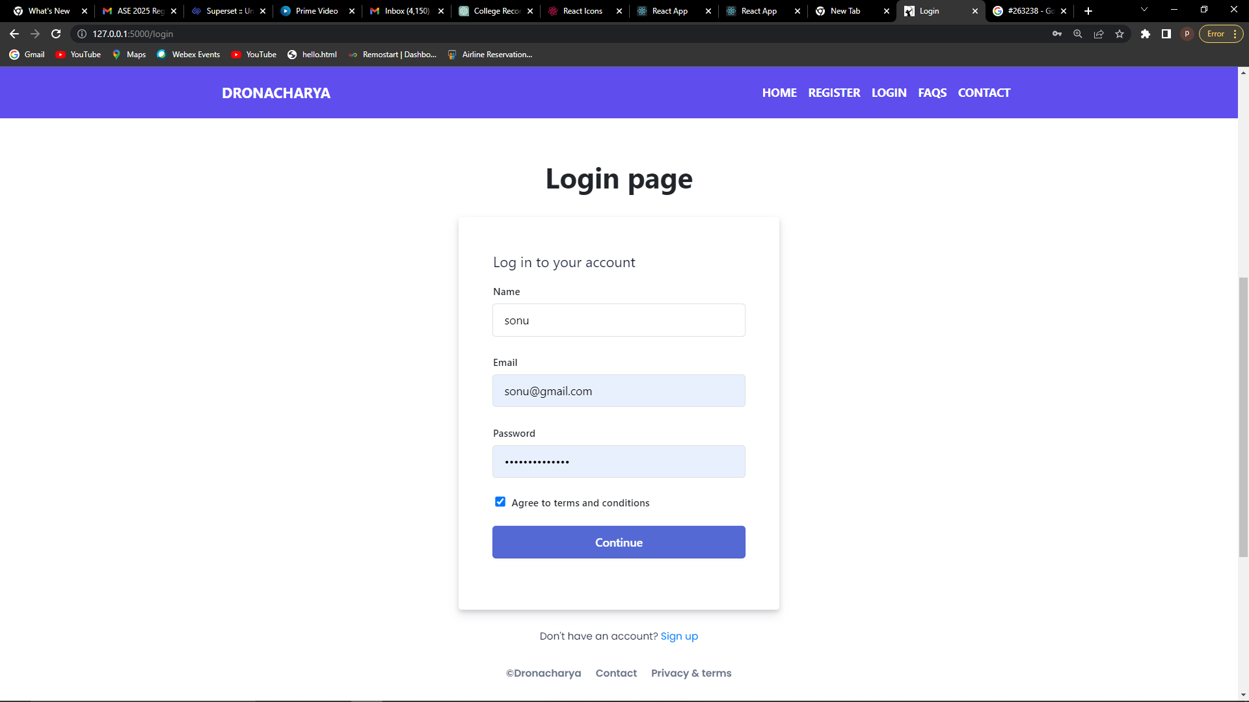
Model I-Frontend Development

Slide 10
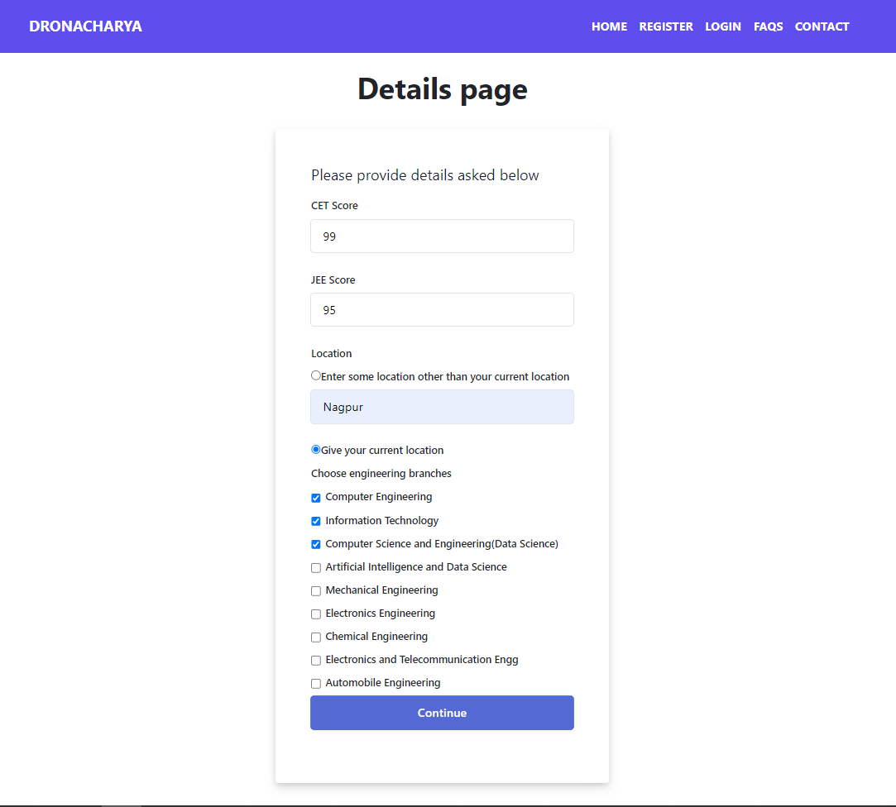
Landing Page

Slide 11
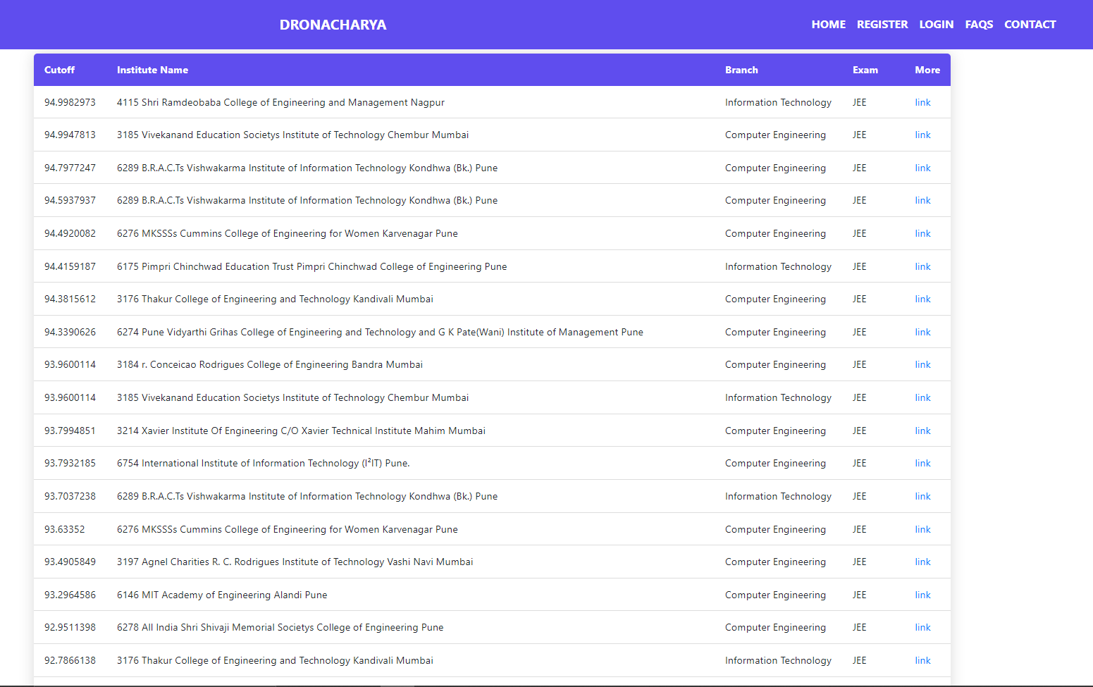
Landing Page

Slide 12

Conclusion
A user-friendly web program called College Recommendation System will reduce students' workload and make it simpler for them to select the right college.
The system will offer a list of colleges from which the student may choose the institution to which he or she wishes to be admitted.
To get the intended results, we have employed a variety of data mining and machine learning methods in the project.
The suggested work serves as a valuable guide for the learner.

Slide 13
Future Scope
The system will be beneficial to students in a number of ways because there is currently no system that can assist students in narrowing down their choices of engineering colleges.
Currently the system only works for engineering college admission, but in the future, we will expand the system by adding more streams and more features to make it useful for other students as well.
Student who are looking for higher education in aboard, but they are facing same kind of issue so will add solution of it also.

Slide 14

Thank You!

